Slide 1
Spreadsheet riding data per year
- has a bunch of numbers rn and raw data
- boss wants to visualize the data yearly, semesterly, ...
Make a query for this:
- Power Plant: Want to know about how many people (and what time) will they go and leave per week?
- Extra: are they freshman, sophomores, ...
- stay away from Dispatch tab bc it is live data.
- Throughout year, they may contact us for quick querying questions. We would tell them immediately if we are able to complete it on time.
- Jan 1, 2021 <= start date for data collection.

Slide 2
Notes
Hopes + prayers:
Worth our time and effort
If at the end, no product but we still learned: good!
Anything else: gravy
Rob keeps track of all ridership data in spreadsheet
Per year
People want to see the data more finely
Boss likes to see charts and graphs
Daily/weekly/monthly
Time sensitive questions: Look at the data, tell us x
How many people went downtown last night
What are the biggest parties and what days are they?
Can you give me a location of x?
We found midway through, students are going to power plant live thurs, fri, saturday nights
If things continue in the springtime, when and how many people will need rides?
10pm, 1-2am
Solution: sent a bus
Note: start data from january 2021

Slide 3

Blue Jay Shuttle
Data Analysis
Miles Lee & Vivian Hung
Notes:
None

Slide 4
DATA CONSULTANTS
Miles Lee
Vivian Hung
Johns Hopkins
Major: BME, CS
Year: Junior
Pronouns: He/Him
Expertise: Python, SQL, statistical models
University of Washington
Major: Informatics Data Science
Year: Junior
Pronouns: She/Her
Expertise: Tableau/Power BI, SQL, Visualizations
Notes:
Both

Slide 5
OVERVIEW
01
02
03
04
05
06
GOALS
ROUGH TIMELINE
LOGISTICS & ORGANIZATION
DATA ANALYSIS PROCESS
NEXT STEPS
Q&A
Notes:
viv

Slide 6
OUR GOALS
How do we utilize Transloc to create data pipelines for (statistical) models?
How can we reduce the cost by decreasing the amount of lyfts called or needed?
How can we reduce pick up times and ride times using data models?
How to use dashboards for quick and easy business oriented decisions?
Notes:
viv
Bullet #4: What does “in the red” look like to you? What is a good day versus a bad day?
Transportation dashboard for passengers

Slide 7
ROUGH TIMELINE
Have an understanding of the data source and potential ways the data can be used.
February
Develop a data pipeline (cleaning, transforming, preparing)
April
Create different statistical models
June
August
Produce dynamic dashboards for seamless business use
Notes:
Miles

Slide 8
LOGISTICS
DATA ACQUISITION
MEETING TIMES
What are the tools, procedures, and security measures involved in acquiring the data?
How will we organize our meetings? Should we create a group chat? Microsoft teams / calendar?
Notes:
Miles
Data acquisition: Employment
Meeting times: email, teams for meetings 1pm est fridays

Slide 9
OUR PROCESS
1
3
5
2
4
Data Understanding and Exploration
Analysis, Predictions, Models
Business Issue Understanding
Data Preparation and Wrangling
Validation and Feedback
Notes:
viv

Slide 10
NEXT STEPS
Set up data acquisition
Schedule next meeting to discuss our understanding of the data
Notes:
Miles
Rob will work with miles 1:1 to get files – straight forward w login – try over email first
Feb 11th 1pm est/10am pst

Slide 11
Q&A
Notes:
Hopes + prayers:
Worth our time and effort
If at the end, no product but we still learned: good!
Anything else: gravy
Rob keeps track of all ridership data in spreadsheet
Per year
People want to see the data more finely
Boss likes to see charts and graphs
Daily/weekly/monthly
Time sensitive questions: Look at the data, tell us x
How many people went downtown last night
What are the biggest parties and what days are they?
Can you give me a location of x?
We found midway through, students are going to power plant live thurs, fri, saturday nights
If things continue in the springtime, when and how many people will need rides?
10pm, 1-2am
Solution: sent a bus
Note: start data from january 2021

Slide 12
THANKS
Miles Lee & Vivian Hung
mlee276@jhu.edu | vvnhng@uw.edu

Slide 14
LOGISTICS
DATA ACQUISITION
MEETING TIMES
BLAH BLAH
What are the tools, procedures, and security measures involved in acquiring the data?
How will we organize our meetings? Should we create a group chat? Microsoft teams / calendar?
“Jupiter is a gas giant and
the biggest planet in the
Solar System”

Slide 15
UNDERSTANDING THE PROBLEM
MARS
JUPITER
MERCURY
Despite being red, Mars is actually a cold place
It’s a gas giant, the biggest planet in the Solar System
Mercury is the closest planet to the Sun and the smallest one

Slide 16
OUR QUESTIONS
MERCURY
VENUS
MARS
Mercury is the closest planet to the Sun
Venus has a beautiful name, but it’s terribly hot
Despite being red, Mars is actually a cold place
SATURN
NEPTUNE
JUPITER
Saturn is the ringed one and a gas giant
Neptune is the farthest planet from the Sun
It’s the biggest planet in the Solar System

Slide 17
STEPS TO FOLLOW
Here you can add the steps to perform
Here you can add the steps to perform
Here you can add the steps to perform
Here you can add the steps to perform
Here you can add the steps to perform
Here you can add the steps to perform
Here you can add the steps to perform
Here you can add the steps to perform
Here you can add the steps to perform
Here you can add the steps to perform

Slide 18
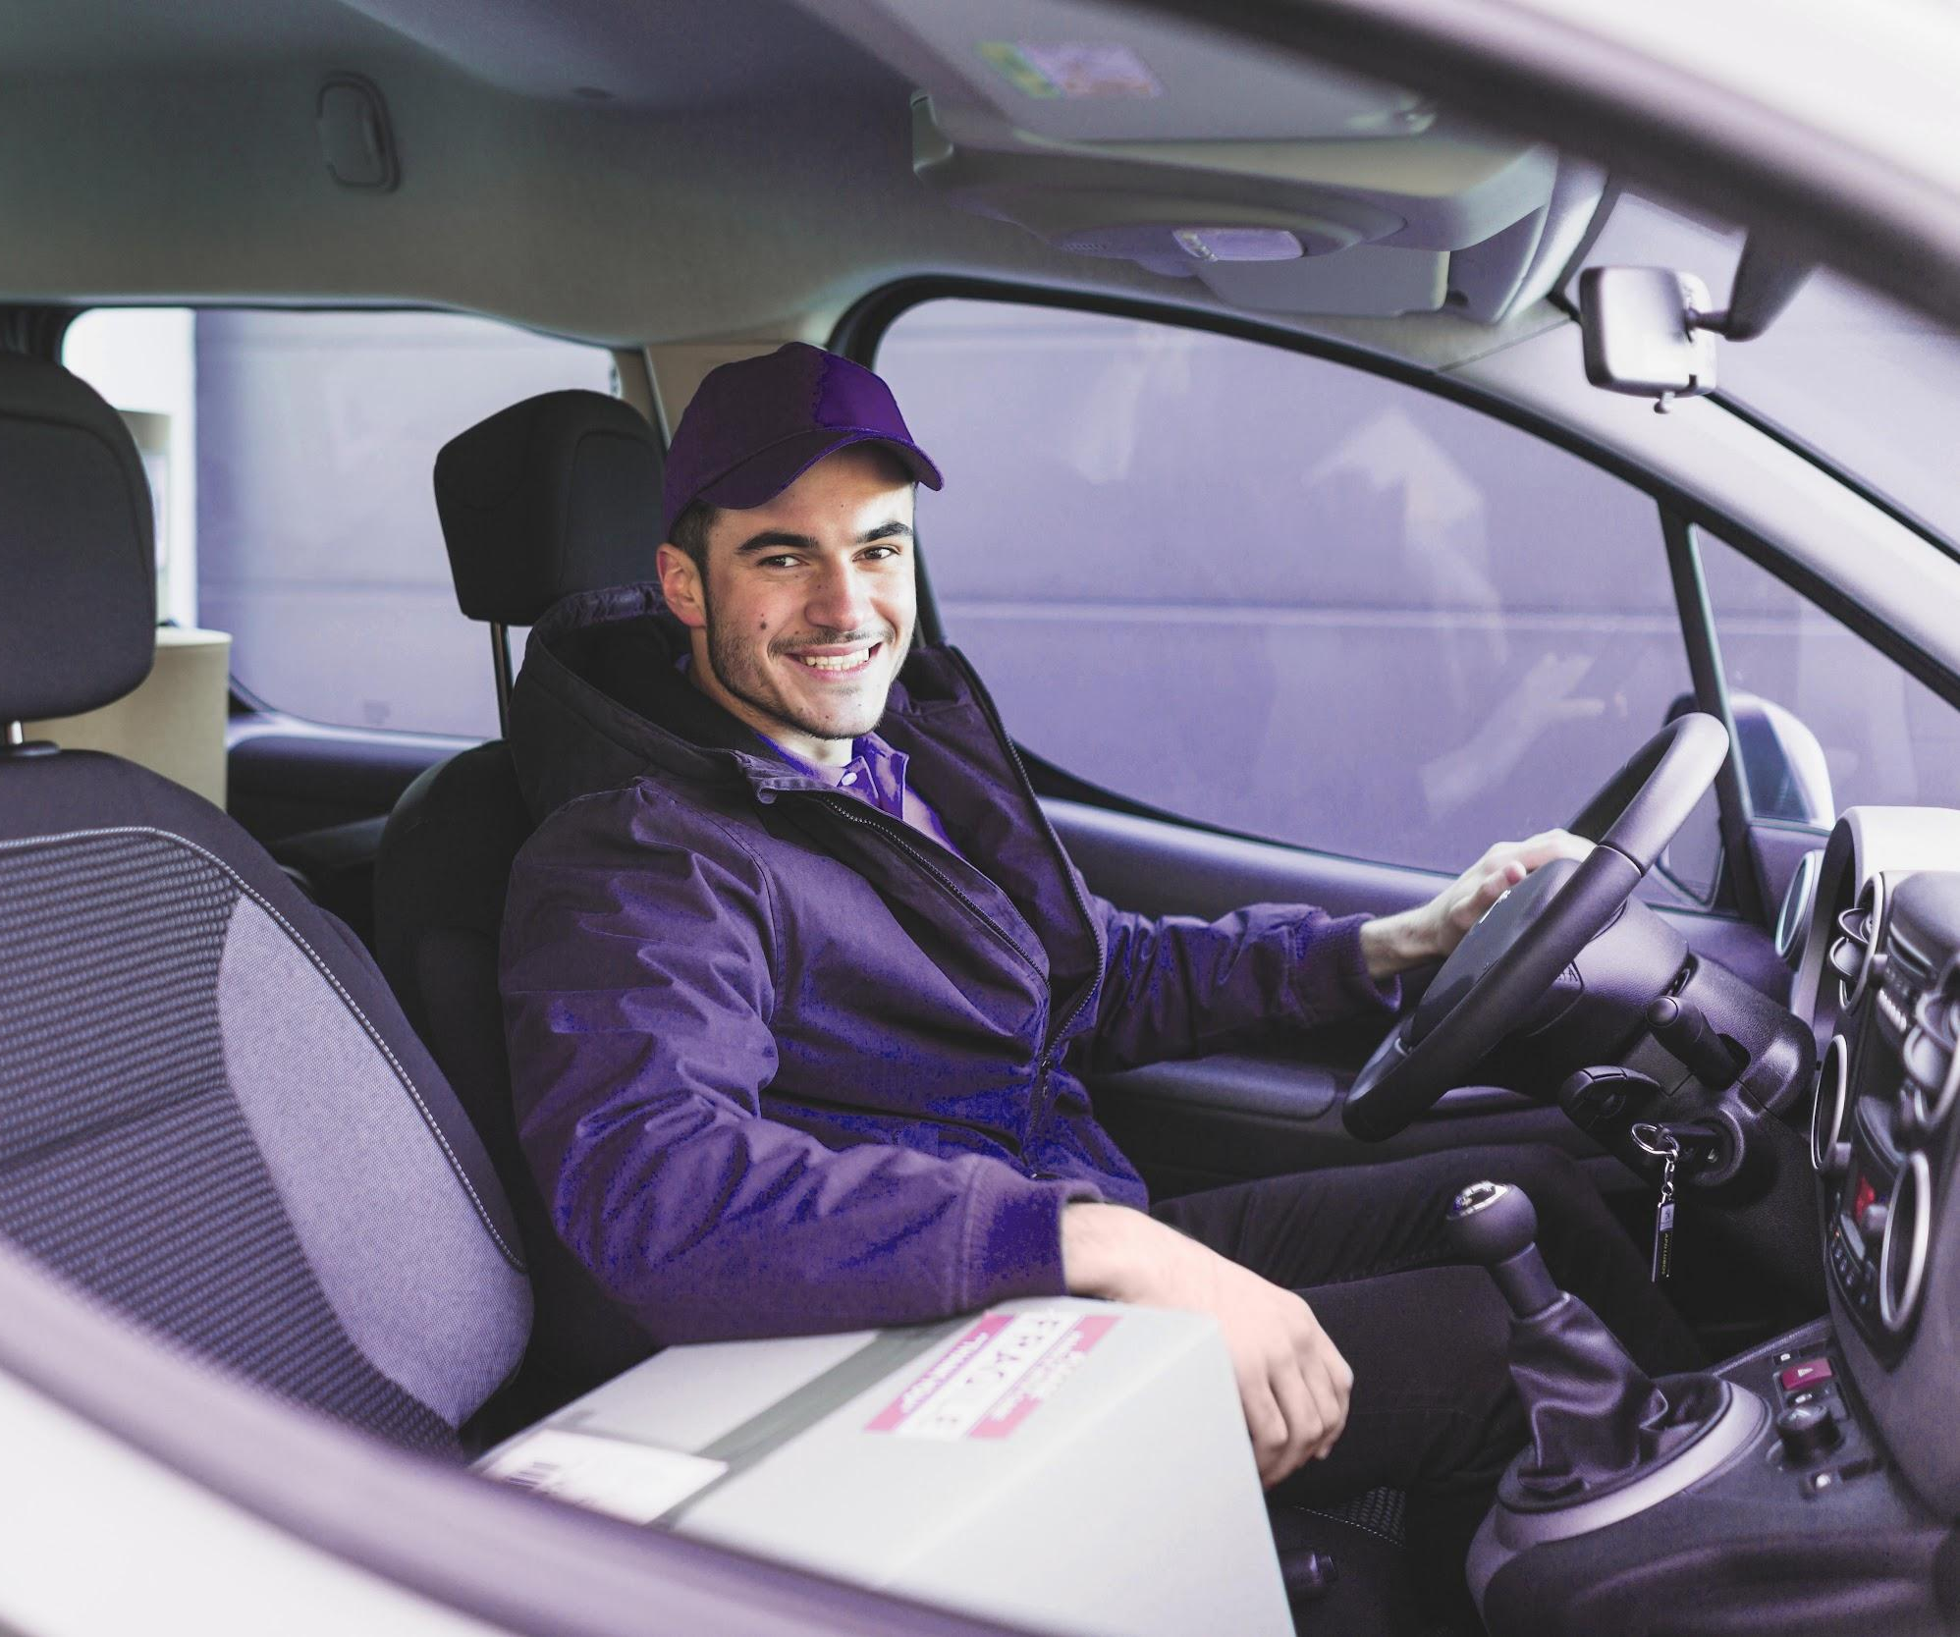
MERCURY
Mercury is the closest planet to the Sun and the smallest one in the Solar System—it’s only a bit larger than the Moon

Slide 19
NEXT STEPS
JUPITER
SATURN
Jupiter is the biggest planet in the Solar System
Saturn is composed of hydrogen and helium
MARS
URANUS
Despite being red, Mars is actually a cold place
Uranus has a beautiful name, but it’s terribly hot

Slide 20
OUR SOLUTIONS
MARS
JUPITER
Despite being red, Mars is a cold place. The planet is full of iron oxide dust
Mercury is the closest
planet to the Sun and the smallest of them all

Slide 21
MAIN COMPETITORS
JUPITER
MERCURY
VENUS
MARS

Slide 22
01
OUR SERVICES
You can enter a subtitle here if you need it

Slide 23
TWO COLUMNS
VENUS
SATURN
Venus has a beautiful name, but it’s terribly hot, even hotter than Mercury
Saturn is the ringed one. It’s a gas giant, composed mostly of hydrogen and helium

Slide 24
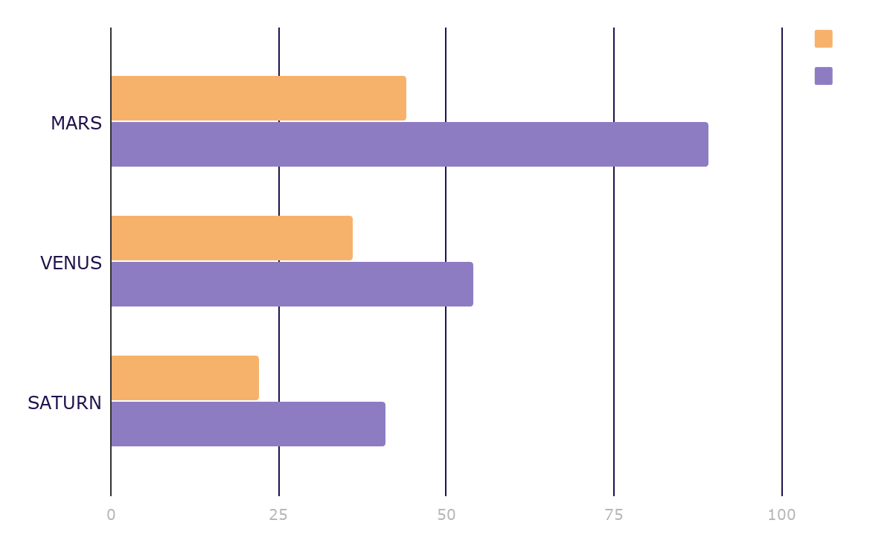
MARKET RESEARCH
JUPITER
Jupiter is a gas giant and the biggest planet in the Solar System
MERCURY
Mercury is the smallest planet in the Solar System
To modify this graph, click on it, follow the link, change the data and paste the resulting graph here

Slide 25
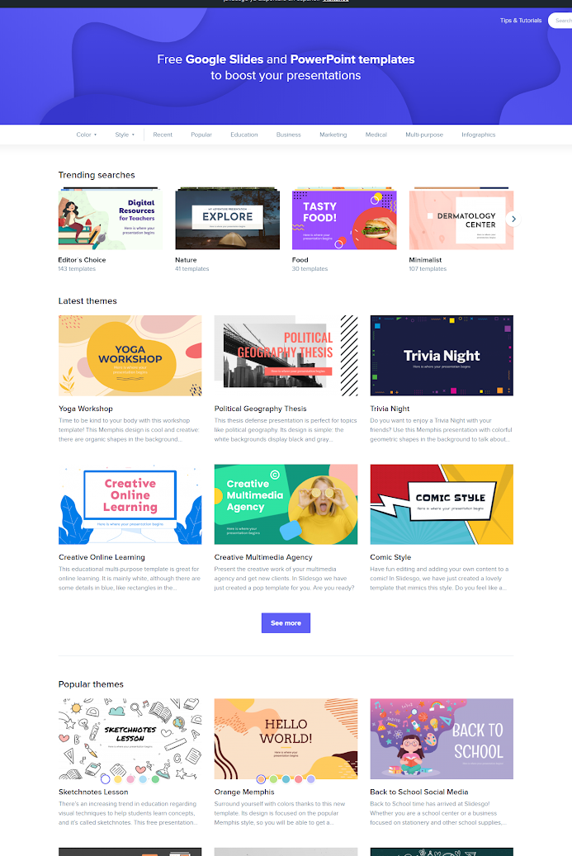
MOBILE APP
You can replace the image on the screen with your own work. Just delete this one, add your and place it in the center of the device

Slide 26
ANALYSIS
TOP RATED VALUES
OUTREACH
Saturn
Venus
Mars
15,000,000
Worldwide Users

Slide 27
CUSTOMER PROFILE
40%
60%
$50.00
20-35
36-45
46-50
Average Spend Per Customer
AGE

Slide 28
15,000,000
Big numbers catch your audience's attention

Slide 29
LOGISTICS
Venus has a beautiful name and is the second planet from the Sun
DATA ACQUISITION
Mercury is the closest planet to the Sun and the smallest one
MEETINGS
Jupiter is a gas giant and the biggest planet in the Solar System
BLAH

Slide 30
02
NAME OF THE SECTION
You can enter a subtitle here if you need it

Slide 31

A PICTURE IS WORTH A THOUSAND WORDS

Slide 32
ALTERNATIVE RESOURCES

Slide 33
Fonts & colors used
This presentation has been made using the following fonts:
Oswald Semi-Bold
(https://fonts.google.com/specimen/Oswald)
Lato Regular
(https://fonts.google.com/specimen/Lato)
#f6b26bff
#d9d2e9ff
#b4a7d6ff
#8e7cc3ff
#351c75ff
#20124dff

Slide 34
...and our sets of editable icons
You can resize these icons without losing quality.
You can change the stroke and fill color; just select the icon and click on the paint bucket/pen.
In Google Slides, you can also use Flaticon’s extension, allowing you to customize and add even more icons.

Slide 35
Educational Icons
Medical Icons

Slide 36
Business Icons
Teamwork Icons

Slide 37
Help & Support Icons
Avatar Icons

Slide 38
Creative Process Icons
Performing Arts Icons

Slide 39
Nature Icons

Slide 40
SEO & Marketing Icons

